Slide 1
Impact of COVID-19 on ABC Company’s Parcel Delivery Business
Final Project Group Assignment
Raihan Reza, Syed Hasan (Group-5)
COMP 603, Fall 2024
December 16, 2024

Slide 2
Executive Summary
Overview:
The parcel delivery trends from 2018 to 2021 reveal significant growth in 2020, primarily driven by the COVID-19 pandemic. During this period, there was an exceptional increase in parcel delivery volumes starting from Week 12 to Week 53 of 2020. The pandemic triggered behavioral changes towards online purchases and deliveries, which directly impacted ABC Company's operations.
Key Notes:
After analyzing the ABC company’s data before, during and after COVID period, the following key points can be summarized-
Volume Surge: The highest parcel delivery volume occurred in 2020.
COVID-19 Period (Week 12–Week 53, 2020): Steady volume increase was noted, corresponding to:
  Weeks 12–21: Sharp rise due to early pandemic-related lockdowns, online shopping and product transfer.
  Weeks 45–52: Seasonal peak during the holiday season (consistent across all years).

Slide 3
Executive Summary
The 2020 holiday peak did not show abnormal growth but reflected continued demand for goods transfers and online purchasing.
All customer groups showed positive growth in 2020 over 2019.
  Growth exceeded the ISGR (Industry Standard Growth Rate) of 11.4%.
  More than 50% of customers within each group grew at a rate higher than the ISGR.
  The “Small” customer group demonstrated the highest percentage growth.
The study and analysis of ABC company’s data can be concluded with the following important findings-
Pandemic-like situations have a positive relationship with parcel delivery services, creating significant business growth opportunities.
Behavioral shifts towards online purchasing, work-from-home dynamics, and stimulus programs (e.g., C.E.R.B) acted as primary drivers for volume increases in 2020.

Slide 4
Background and Objectives of the Study
Background:
The COVID-19 pandemic impacted Canadian businesses in various ways. Some businesses saw unprecedented growth due to increased e-commerce activity, while others found their product or service revenue plummeted. At ABC Company, there are customers from all sectors who have experienced COVID in their unique ways.
Objectives:
Analyze the dataset (COVID_Parcel_Business.csv) that contains customer IDs, the year, the week number, and the number of parcels shipped that week.
With appropriate analysis, summarize the findings that are important for the business like impact, trend, growth, retention, etc.

Slide 5
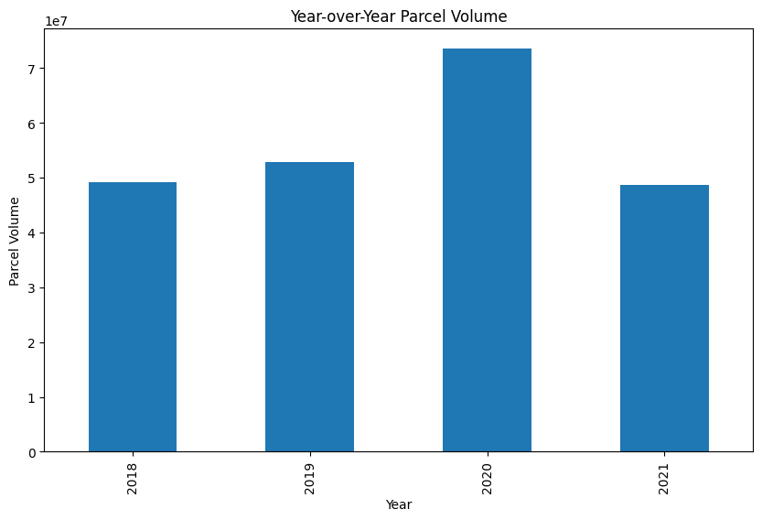
Business Impact of COVID in Pre and Post COVID period
Among the 4 years from 2018 to 2021, in 2020 there was the highest parcel delivery volume
During the COVID observation period from Week 12 to Week 53 of 2020 business experienced steady increase

Slide 6
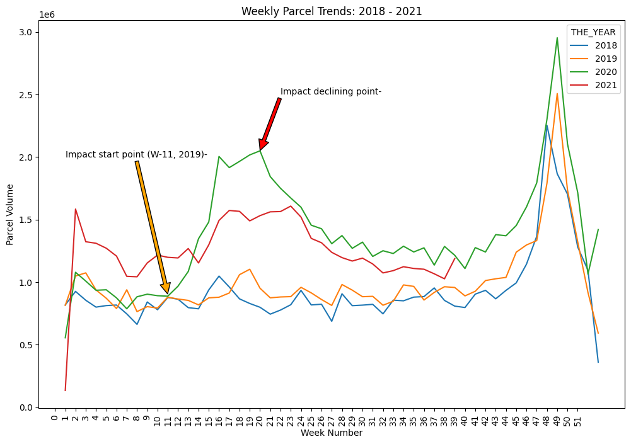
Business Impact of COVID in Pre and Post COVID period
The green line (2020) shows an exceptional increase in parcel volume starting at week 11 and stretching up to week 21, corresponding to the early pandemic period when lockdowns boosted online shopping
Other than 2020, parcel delivery volume showed a generic/organic growth and common seasonality

Slide 7
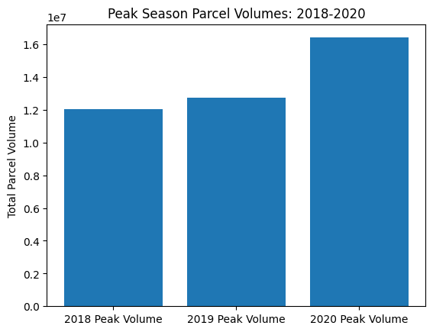
Peak Season: Observations
All years displayed a peak starting from Week 45 to the end of the year (Highest during Weeks 48–52), likely due to the holiday season during increased parcel deliveries.
However, 2020 peak season did not show any abnormal growth, except some impact of behavioral change towards online purchase, goods delivery and product transfers
Growth Due to COVID impact: 3.67 Mn Parcel

Slide 8
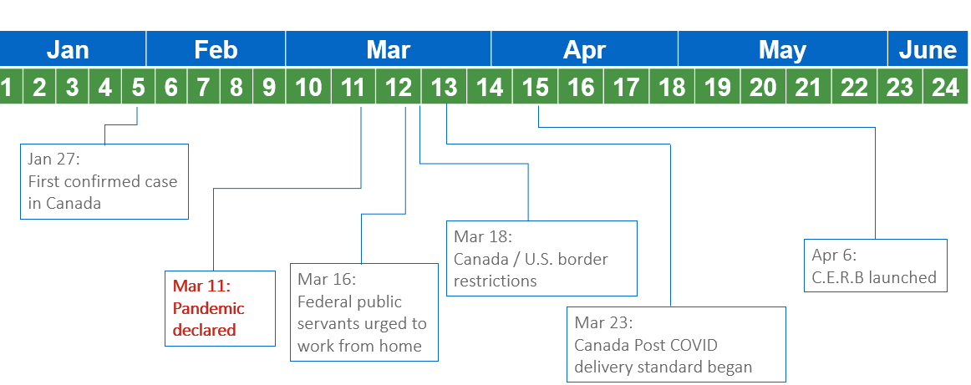
Possible Reasons for Sharp Increase in W11-W21 2020
Important events/declarations and likely changes on mass people in Canada-
Week 11: Pandemic declared
  People started accumulating necessary goods
Week 12: Work From Home
  Less outdoor movement, Indication for further delay of normalcy
Week 12-13: Canada/USA Border restrictions
  Indicated scarcity of Imported goods, led to accumulation of goods
Week 13: Canada Post COVID delivery standard
  Further strengthening of delivery service
Week 15: C.E.R.B Launched
  Response benefit lashed further purchase power leading to more online order and accumulation of goods

Slide 9
Customer group’s Growth during 2019-2020
Overall customer growth in different Customer Groups:
Enterprise (>500K in 2019) | 46.78%
Large (200K-500K in 2019) | 46.23%
Medium(10K-200K in 2019) | 49.19%
Small (1K-10K in 2019) | 62.34%
Total customers: 1061
All the groups showed positive growth in 2020 from 2019 (more than the ISGR (11.4%) in terms of parcel delivery volume.

Slide 10
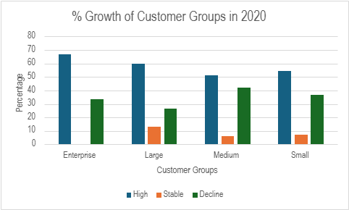
Percentage of customer Growth during 2019-2020
 | High/Growing (GR > ISGR) | Moderately Growing (0% < GR <ISGR) | Declining (GR < 0%)
Enterprise | 66.67% | - | 33.33%
Large | 60.00% | 13.33% | 26.67%
Medium | 51.15% | 6.32% | 41.95%
Small | 54.30% | 7.33% | 36.74%
More than 50% Customers within each customer group has grown at a rate more than ISGR 11.4%
Enterprise Group showing the highest percentage
ISGR 11.4%
GR: Growth Rate
Notes:
Definition of Customer Group (Based on 2019 parcel delivery volume):
Enterprise: Annual volume > 500K pieces
Large: Annual volume between 200K - 500K pieces
Medium: Annual volume between 10K - 200K pieces
Small: Annual volume between 1K -10K piece
Industry standard growth rate (ISGR) calculated by comparing pre-COVID 2020 volumes to the same period in 2019.
Current period: week 1 to week 15, 2020
Previous period: week 1 to week 15, 2019

Slide 11
Addition and Churn of Customers in 2019-2020
Definition of Customer Growth Categories
There have been 15 customers lost during 2020 (who were in the 2019 customer list), among them
  1 is from ‘Medium’ customer group
  14 are from ‘Small’ customer group
No new customer has been added in 2020.
Label | LOW | HIGH
New Customers | 0 parcels in 2019/early 2020 | 1+ parcels during COVID period
High Growth Customers | Greater than ISGR in the COVID observation period | unlimited
Stable/ Moderately Growing | 0% growth during COVID period | ISGR during COVID period
Declining Customers | N/A | Negative growth during COVID period
Lost Customers | 1+ parcels in 2019/early 2020 | 0 parcels after onset of COVID period

Slide 12
Overall impact of COVID on volumes and revenue
All the customer groups shown a positive growth during COVID observation period (week 12 to week 53)
Notes:
Assumptions:
Discounts were applied to customers based on customer group (Enterprise-22%, Large-17%, Medium-10% & Small-4%)
Base cost of sending a parcel without a contract is $22.00.

Slide 13
Overall impact of COVID on volumes and revenue
From 2019 to 2020, both Volume and Revenue have shown a steady positive increase in each segment during COVID observation period.

Slide 14
Recommendations
Conduct further in-depth analysis to find more specific reasons for business growth
Develop strategies to capitalize future business opportunities if pandemic-like situation arises.

Slide 15
Thank You

